Slide 1
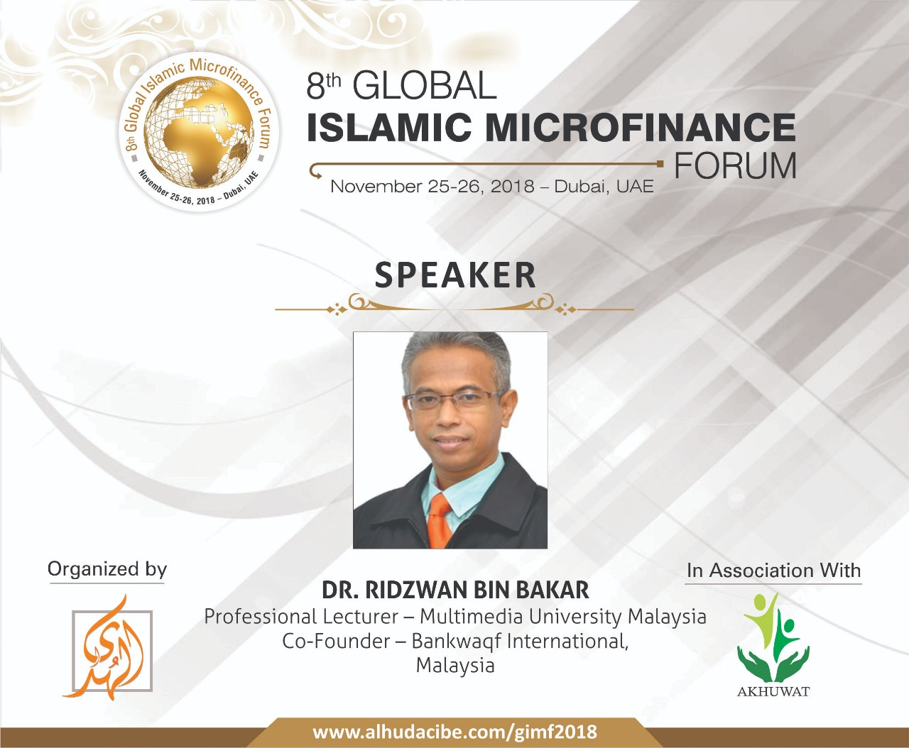



WAQF Value Based IR4.0
BWi Perspective

Slide 2
FLOW OF PRESENTATION
1. Waqf Snapshot - Untap Asset
2. Waqf Revival
3. Waqf Value Based IR 4.0
4. BWi Waqf Solution- WaqfCoin & Application
5. Take Away
.
We are the Servant of ALLAH…..

Slide 3

WAQF SNAPSHOT
UNTAP ASSET

Slide 4
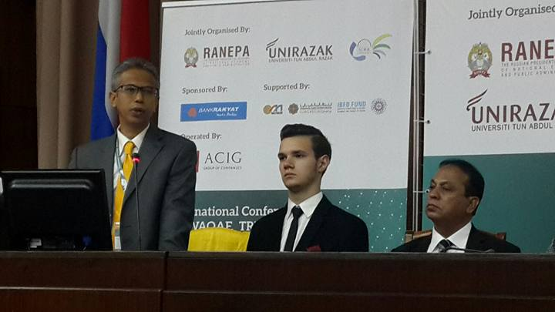
You should come 10 years ago…. Non-Muslim Moscow
Corporate Waqf University Model (Ridzwan,2015)
THANK YOU EVERYONE FOR YOUR SUPPORT...

Slide 5
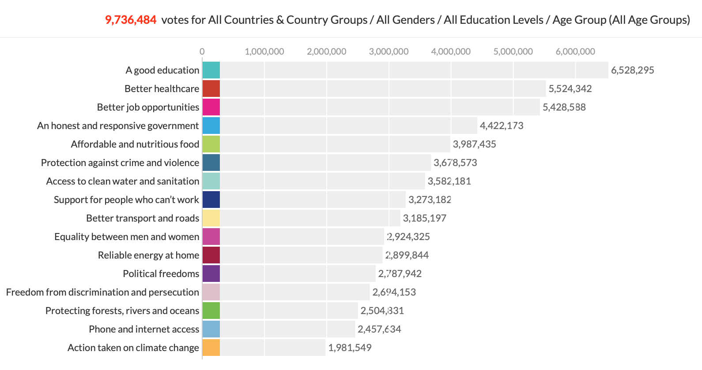
Analytics: The World We Want and MY World Stats: 7,138,023 Votes (17 Feb 2015)
WITHIN
MAQASID
SHARIAH

Slide 6
SNAPSHOT WAQF UNTAP ASSET. USD 1.3 Trillion is not small…..
Islamic finance is forecast to grow exceeding USD 2 trillion (SC,2016). In fact, Islamic finance/capital market has the scale to support Islamic economic system, and that include waqf.
The value of global and Malaysia Waqf assets is estimated at USD1.3 Trillion and USD325.4bil respectively.
(Source: Islamic finance news, 2012)
THE QUESTIONS ARE:
Where are these assets?
What when wrong with Waqf Practices?
Why it is not productive?
How to wake up the sleeping giant?

Slide 7
WAQF REVIVAL

Slide 8
Waqf- Basic
Waqf ”Stand still, hold still, not to let go” (Maliki- habs)
Waqf established by founder (waqif) by dedicating an asset for benefit of a defined group.
Waqf deed determines:
  Objectives for which waqf is created
  Way(s) its revenues/fruits/services can be used
  Mutawalli – Professional manager to manage and execute waqf deeds.

Slide 9
Waqf: Fundamentals
Good objective or birr – good intention
WAQF ownership belongs to Allah
Waqf is usually perpetual—but can be temporary and partial.
Can be created for various objectives
  Philanthropic or public (khayri or aam)
  Family or private (ahli or khass)
  Mixed (mushtarak)
  Religious and charitable/social

Slide 10
Less Attention is given to Type D
Waqf Types of Beneficiaries
Type Beneficiaries | Religious | Philanthropic/ Social
Family | A | B
General Public | C | D
Type A—Not too common (tombs)
Type B—Waqf for family members
Type C –Mosques, graveyards, etc.
Type D—Waqf for enhancing welfare
Source: Habib Ahmed (Durham University)

Slide 11
Awqaf Contemporary Issues
Due to different reasons, awqaf have degenerated both as a concept and in practice
The concept of waqf is misleading:
  Waqf is only for religious purposes
  Waqf can be established in real estate only
  Lack of awareness that waqf can be productive asset/organization used for social/philanthropic purposes

Slide 12
Awqaf Contemporary Issues
In practice—many awqaf have become unproductive assets
  Waqf not created for socio-economic purposes
  Lack of institutional/organizational development
  Lack of supporting institutions
  Many waqf assets untraceable

Slide 13
WAQF VALUE BASED
IR 4.0
(Industrial Revolution)

Slide 14
Revival of Waqf as the Sacred Enterprise
Bank Waqf International (BWi) and International Waqf Action Council (iWAQF)
Revival Of WAQF As The Sacred Enterprise
Moving Forward

Slide 15
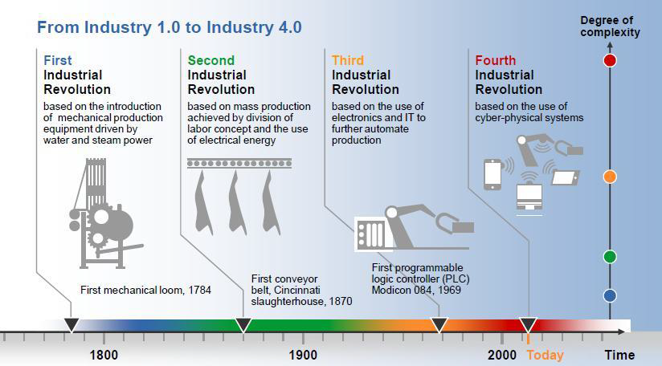
The Industry 4.0 Transformation

Slide 16
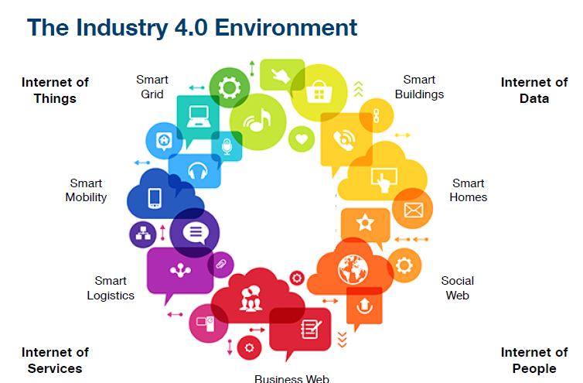
Mapping Waqf and Industry 4.0

Slide 17

Waqf Innovation
WAQF COIN & WaqfAPP
BANK WAQF INTERNATIONAL (BWi) empowering people

Slide 18
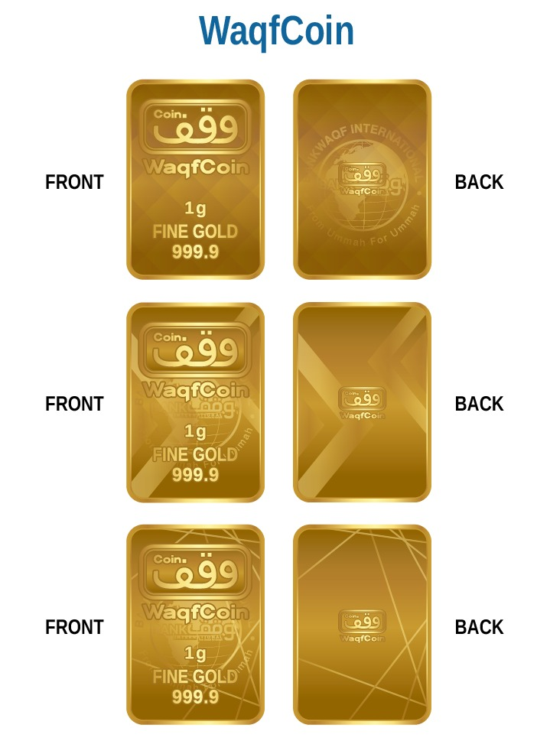
Waqf Based Economy empowering Ummah
BWi WAQF IR 4.0 Fintech and innovations
HOW….?
Example of Projects under Bank Waqf International
Waqf SmartCity in Malaysia and Indonesia
Waqf Hospital in Johor, Putrajaya and Negri Sembilan (in progress)
WaqfMart Supermarket (Indonesia & Malaysia)
Universit Al Quran based on Waqf
Waqf Agriculture
Waqf Accounting Standard for Malaysia Government

Slide 19







GLOBAL FINANCE CURRENT PROBLEMS
FOREX - Forex Malaysia and Indonesia currency against USD is weakening. Global economic uncertainty. Fiat money destroying purchasing power of people.
LESS PURCHASING POWER
Inflation getting tougher. Interest rates is projected to going uptrend.
Fiat money is getting less value and involve risk in both financing and investing.
PROFIT RATE Islamic Bank profit rate and conventional interest rate are unable to beat inflation.
Riba is HARAM. Islamic Banking system is also failed to help just financing.
RISK Global Kaspersky Lab has indicated that all countries will face online financial fraud and scam.
In Indonesia, for instance, 26 percent of online consumer had experience online financial fraud.

Slide 20
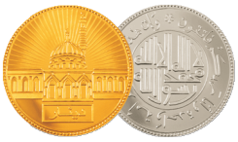
SOLUTIONS – WaqfCoin Based on GOLD
”the Prophet (SAW) gave him a Dinar to buy him a sheep, and he bought two sheep for him, then he sold one of them for a Dinar, and
bought a Dinar and a sheep to the Prophet (SAW). The Messenger of Allah (SAW) prayed for blessing for him. Sahih “
Hadith Narrated By Urwah Al-Bariqi In Sunan Ibn Majah
,
According to Islamic law, the Islamic dinar is a coin of pure gold weighing 72 grains of average barley. Modern determination of weight range from 4.25 grams to 4.5 grams of gold

Slide 21




SOLUTIONS – WAQF COIN GOLD
Gold has been recognized to store value, stable and trustworthy.
It has long history of trust value compare to Fiat Money.
Gold is accepted worldwide, anytime, anyplace.
Gold kept and stored at approved institution, is save and insured.
It protects investors from systematic, unsystematic risks and potential
financial crisis.

Slide 22
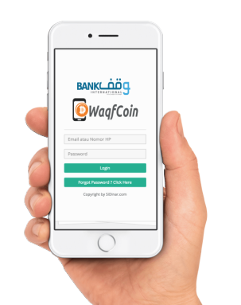
ISLAMIC FINTECH SOLUTIONS – WAQF COIN
is a patent product of Bank Waqf International (Bwi)
Is a principal business partner for gold trade based on aqad murabahah. With wadiah mode of savings facilities.
Waqf coin provides security and stored value based on market value of the gold.

Slide 23
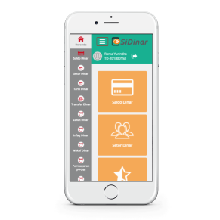




UNIQUE FEATURES
1. WaqfCoin App One Ummah
The Application is developed by young Muslim with the
aim to consolidate global economy Based on waqf
2. Free from Riba, maisir (speculation) and gharar (not certain)
3 Protect against inflation and crisis
Stored Value 100% in form of physical gold kept at
Vault Safe Deposit in PT Pegadaian (Persero) Indonesia.

Slide 24
FEATURES
5. Platform to Buy and Sell Gold
Various mode of transaction will be developed from time to time.
This will be big online market
6. Multi Payment Channel
7. Transfer of WaqfCoin among members
8. Social Transaction and Commerce
Potential platform for social work including zakat distribution, education,
Disaster fund etc

Slide 25
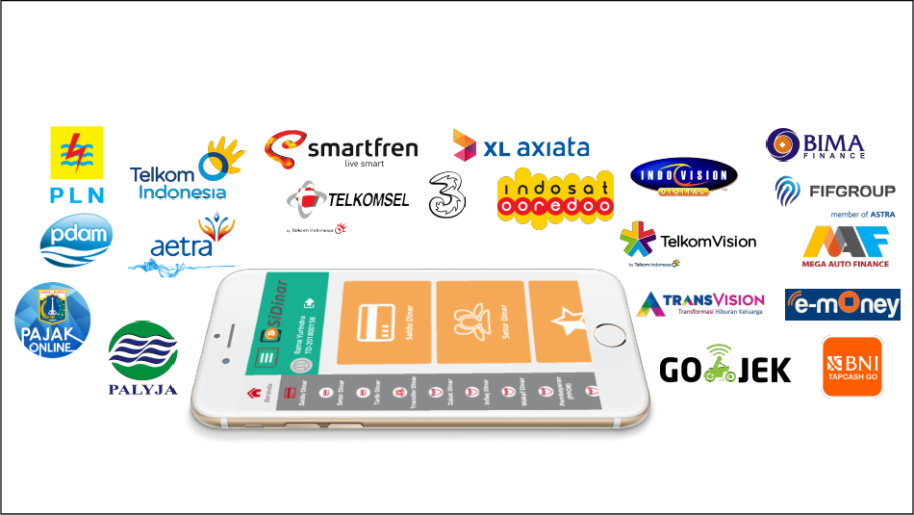
MULTI PAYMENT ONLINE

Slide 26
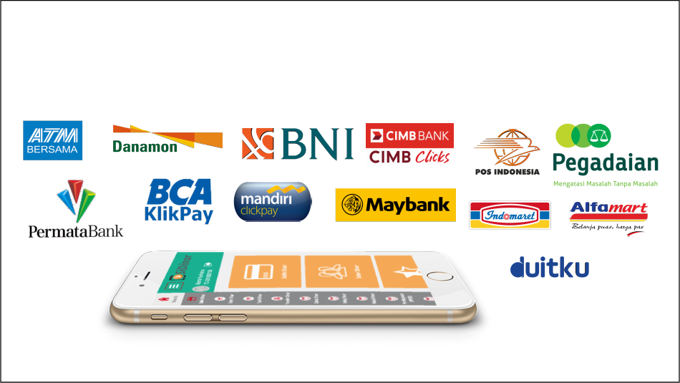
VA R I O U S PAY M E N T C H A N N E L

Slide 27
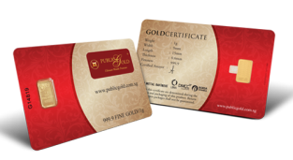
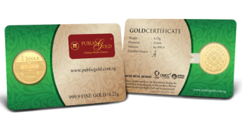
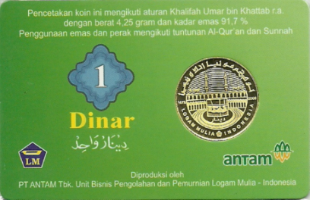
TYPE OF DINAR
Dinar 22
Dinar 22
LM Gold Bar
5
Gram
Karat : 2 2 . 0 / 9 1 , 7 %
Karat : 2 4 . 0 / 9 9 , 9 %
Karat
:
2 4 . 0 /
9 9 , 9 %
Berat : 4 . 2 5 g r a m
Berat : 4 . 2 5 g r a m
Berat
:
5
gram
Dimensi : 2 0 m m
Dimensi : 2 1 m m
Dimensi
:
2 1 m m
Produksi PT ANTAM Tbk / PERURI
Produksi Nadir Metal Rafineri
Produksi
Nadir
Metal
Rafineri

Slide 28
PRESENTATION TAKE AWAY

Slide 29
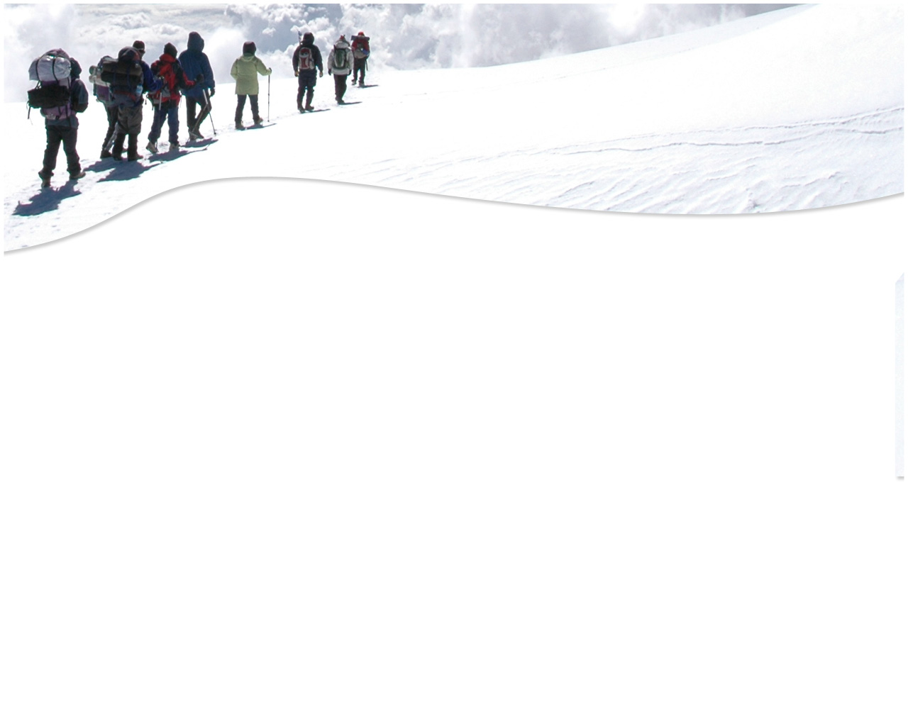
TAKE AWAY
WAQF: WHAT IS OUR ROLE?
There is a need to empower ummah through Waqf based economy ie.
Waqf productive.
All of us are accountable to preserve business based on Maqasid Shari’ah
IR4.0 through Waqf Innovation by Bank Waqf International provides
empowerment for ummah economic reforms, business mindset,
funding, investment and charity.
Waqf Coin is to facilitate the movement of the sleeping giant of untap asset
into productive generating income through ummah empowerment.

Slide 30
Key Strategic Take-Away
Putting Wealth Back onto its Proper Place in the service of Right Livelihood for the
Common Good

Slide 31
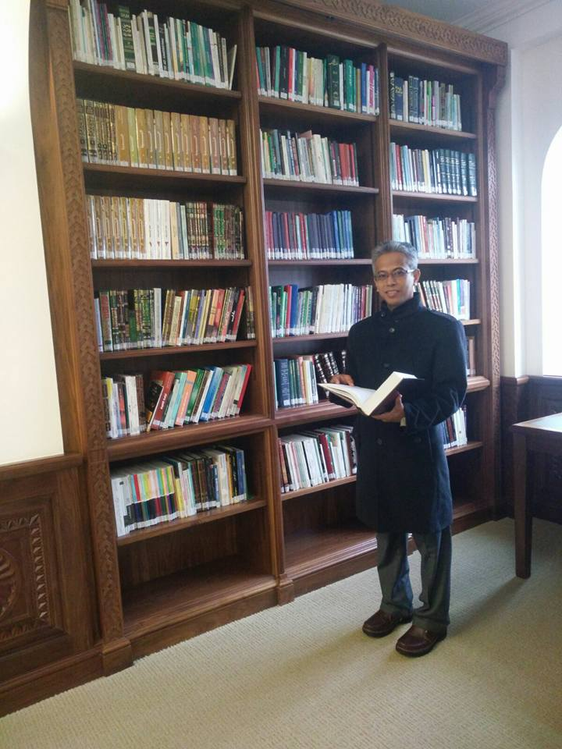
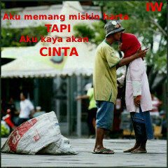
Bank Waqf International….
The World has abundance of wealth
The Issue is not about scarce resources and limited Wealth
It is an issue of
AMANAH
http://ridzwan-bakar.blogspot.com Inspiring people Beyond Lecture Hall

Slide 32
END OF SHARING
Dr Ridzwan Bakar
Email: drridzwanbakar@gmail.com
Mobile Phone: +60132090000
**facebook/drridzwan**

